Slide 1
Presenter notes
Resources:
GitHub Apps
GitHub Actions
GitHub Webhooks and events
Octokit libraries
Probot
GitHub ToolKit for GitHub Actions
JavaScript action template
Container action template
GitHub Marketplace filterable by Apps or Actions
GitHub Developer Documentation
GitHub REST and GitHub GraphQL APIs
GitHub Apps
Best practices for integrators
Rate limits
Pagination
Octokit plugins
Resource limitations
Introduction to GraphQL videos
Insomnia tool for GraphQL demos
https://graphql.org/learn/introspection
Demo prep:
None
FAQ:
No FAQ built, but question slide at end of module
Customer stories:
N/A
Expected timing:
N/A

Slide 2
GitHub API

Slide 3
This module will enable you to:
Discuss API possibilities and approaches, including GraphQL and REST

Slide 4
API features
API authentication methods
REST vs GraphQL APIs
GitHub App vs GitHub Actions
Webhooks and events
Automate functionality within GitHub via Apps and APIs
Notes:
We can take questions as we go
We are going to cover the topics on the slide
Details to be considered:
- What is the difference between the GitHub RestAPI and the GraphQL API?
- When it is better to leverage a GitHub Apps over GitHub Actions and visce versa.
- Learn what can be automated with each of the two technologies.

Slide 5

API authentication methods
Personal access token (PAT)​
OAuth token
GitHub application authentication
Installation authentication
Notes:
The are 4 primary ways to authenticate an API.
1. Personal Access Tokens 2. OAuth application access
3. GitHub Application Authentication
4. Installation Authentication
Important:
Deprecation Notice: GitHub has discontinued password authentication to the API effective November 2020. You must now authenticate to the GitHub API with an API token, such as an OAuth access token, GitHub App installation access token, or personal access token, depending on what you need to do with the token. For more information, including scheduled brownouts, see
https://developer.github.com/changes/2020-02-14-deprecating-password-auth
In the next slide, we'll focus on when to each of these methods is implemented and their features.

Slide 6
API authentication
Method | Features and use | Example
Personal access token (PAT) | Single Sign-On Do not use for organizations Has access to all the same repos as the user | ff3485a8624460a855540c6592698d2f1812843
OAuth token | Used inside of an application to access user information Acts on behalf of the user | git clone https://github.com/username/repo.git Username: your_username Password: your_token (See previous example)
GitHub application | Provides high level management app information Request access tokens for app installation Access to specific repos can be granted/restricted | require 'openssl' require 'jwt' # https://rubygems.org/gems/jwt # Private key contents private_pem = File.read(YOUR_PATH_TO_PEM) private_key = OpenSSL::PKey::RSA.new(private_pem)
Installation authentication | Perform actions in the API | -
Notes:
Let's look at the features and uses of each method along with a few examples.
PATS (Personal Access Tokens)
Used to make simple API requests. Generally not used on an organizational level. If organizations require single sign on, then that must be authorized on a per PAT basis
These should not be used for company automations, plan for what happens when you leave the company or change responsibilities
One token for everything is an anti-pattern. Each token should have a specific use and a descriptive name
For security reasons, a token should ideally only have the authorization to do what it needs.
Scopes specification can be found on docs.github.com at https://docs.github.com/en/free-pro-team@latest/developers/apps/scopes-for-oauth-apps#available-scopes (Note to presenter: Point out the available scopes)
*******************
Note to presenter: Demo github.com/settings/token - Providing a note, selecting scopes and generating the token.
*******************
OAuth application access
Similar to a PAT in that it has scopes for access. But, the token is not displayed in GitHub settings.
Demonstrate the following:
Obligatory entries to register a new OAuth application
The client ID
The client secret – The secret is displayed in the browser only once
Listed applications that have permissions through the OAuth app
The user can revoke access of the application that uses OAuth
Point the audience to this documentation for details: https://docs.github.com/en/rest/guides/basics-of-authentication
GitHub Application Authentication
Authenticating as a GitHub App allows you to retrieve high-level management information about your GitHub App and request access tokens to install the app.
The process
Provides you with an OAuth Client ID and secret
Offers the developer a more granular method of defining access (as opposed to the broader scope found with personal access tokens.
Has an expiration period of 10 minutes which includes:
Generating a JSON web token using a PEM file and an app ID. An algorithm takes the PEM file and app ID to return the token.
Creating an access token (which resembles a personal access token) to get an installation ID
Making authenticated API requests using the ID.
Scope changes can be made, but then each installation will ask the user for new permissions
Details provided in the documentation: https://docs.github.com/en/free-pro-team@latest/developers/apps/authenticating-with-github-apps
Installation Authentication
Authenticating as an installation lets you perform actions in the API for that installation. Before authenticating as an installation, you must create an installation access token. These installation access tokens are used by GitHub Apps to authenticate.

Slide 7
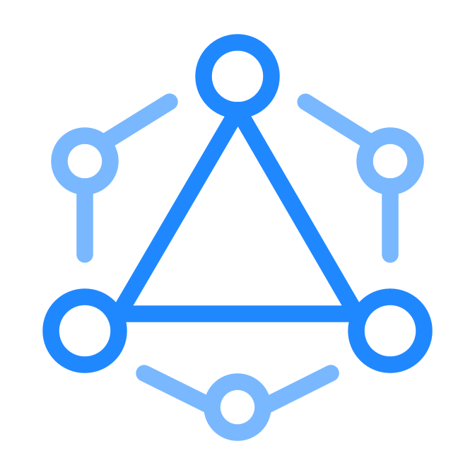
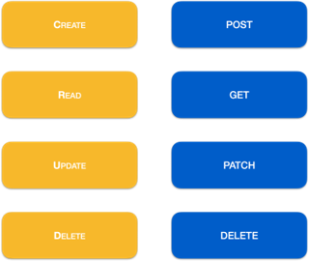
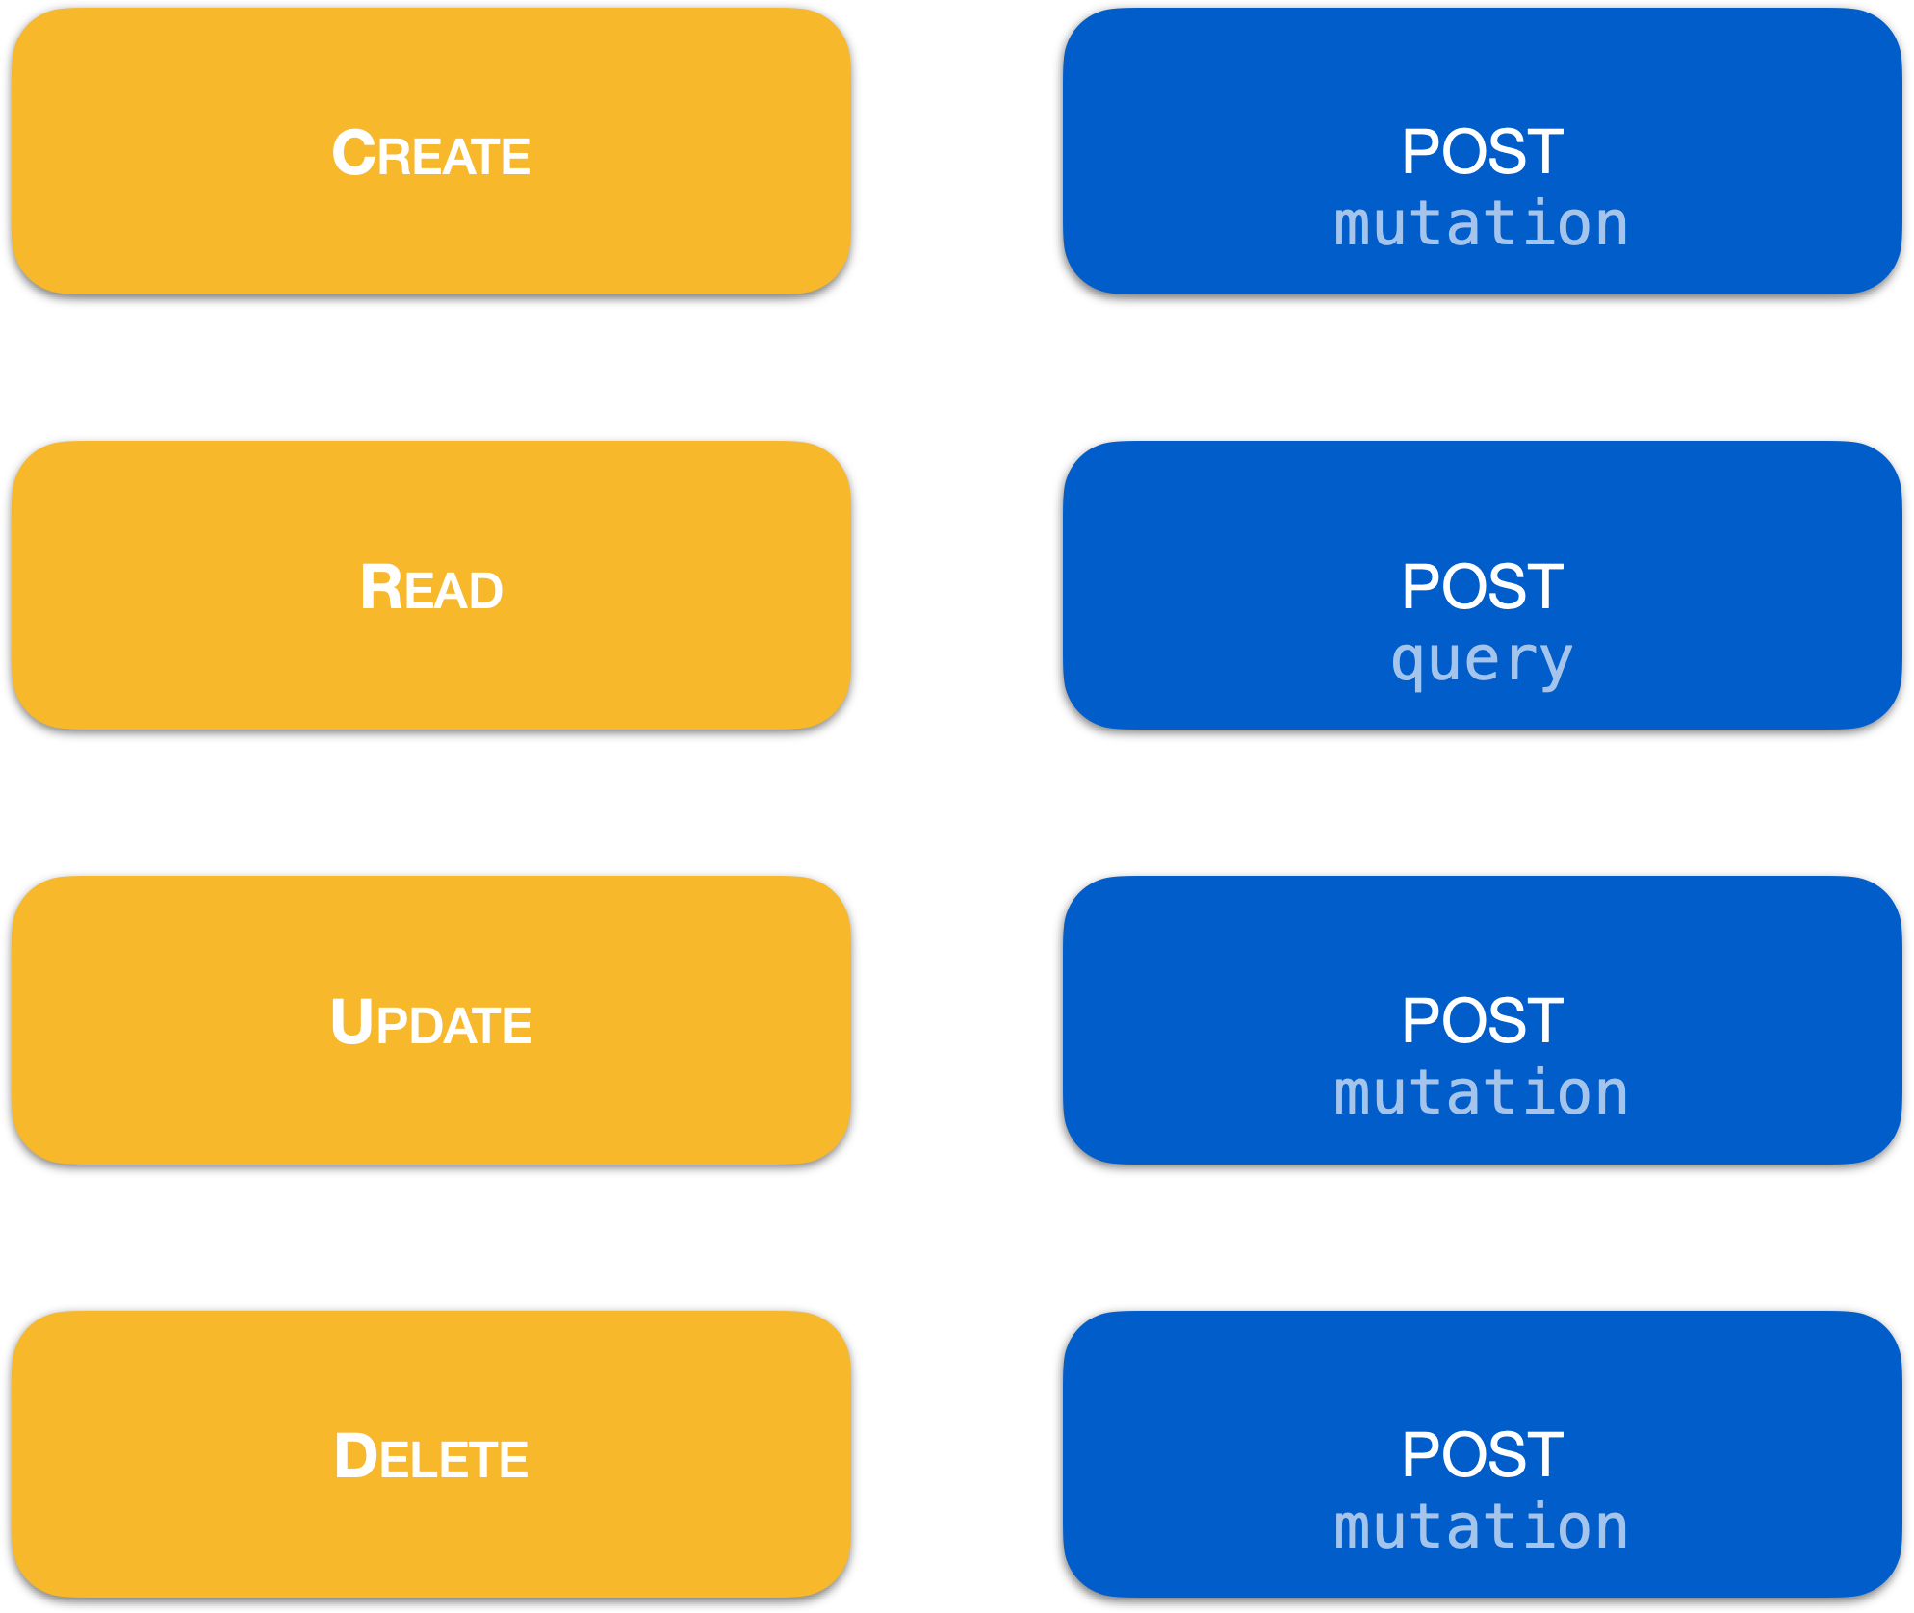
REST vs. GraphQL APIs
REST
GraphQL
Notes:
*********************
Note to presenter:
Questions for audience interaction:
Ask the audience about their preference between the two APIs
What is the audience familiarity with each?
Experience with each?
- Who has worked with GraphQL?
- Who has worked with REST?
*********************
Let's analyze the similarities and differences between the REST and GraphQL APIs.
REST
The screen shows a comparison.
Details at https://docs.github.com/rest
POST Used for creating resources.
GET Used for retrieving resources.
PATCH Used for updating resources with partial JSON data. For instance, an Issue resource has title and body attributes. A PATCH request may accept one or more of the attributes to update the resource. PATCH is a relatively new and uncommon HTTP verb, so resource endpoints also accept POST requests.
DELETE Used for deleting resources.
PUT Used for replacing resources or collections. For PUT requests with no body attribute, be sure to set the Content-Length header to zero.
HEAD Can be issued against any resource to get just the HTTP header info.
GraphQL
Typically used for read operations.
Gets the data you need, nothing more
Uses nested fields
Features strong typing
Details at https://docs.github.com/graphql
A single REST API call retrieves a large payload, with a lot of additional data that is not needed.
Notice here that under the hood, C.R.U.D., in http verbs are all done as posts. This is because a GET request would get the entire GraphQL schema which is helpful for introspection
GraphQL's strong suit lies in querying data that is nested. Querying with nested fields lets you replace multiple REST calls with fewer GraphQL queries.
GraphQL schemas are strongly typed, making data handling safer.

Slide 8
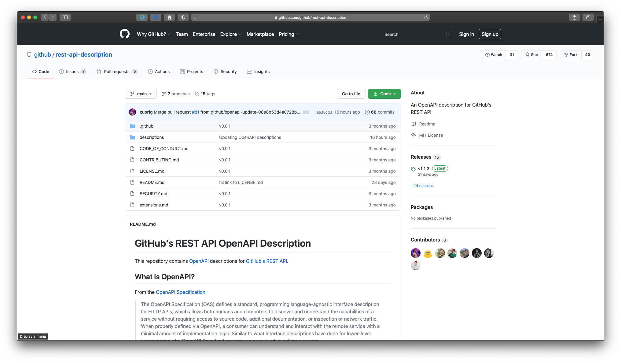
REST API OpenAPI description
https://github.com/github/rest-api-description
Notes:
Let’s dive into the REST API:
GitHub has open sourced its REST API description using the open API format.
https://github.com/github/rest-api-description/blob/main/descriptions/api.github.com/api.github.com.json
This makes it easier to provide wrappers and libraries around the api since there is a machine readable (JSON) description of each API endpoint

Slide 9

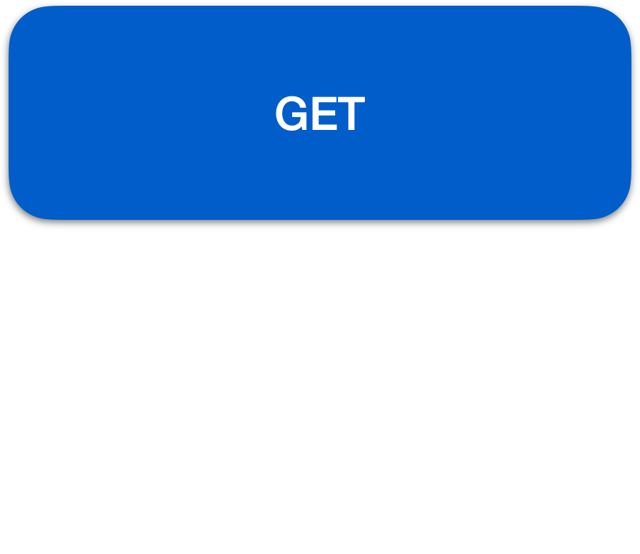
GraphQL introspection
Notes:
Refer to https://graphql.org/learn/introspection
In GraphQL, schemas
- describe the shape of a data graph
- specifies which queries are available to execute against a data graph.
Clients need a way to ask a GraphQL schema for information about what queries it supports.
The GraphQL introspection system allows clients to make those queries.

Slide 10


An API learning resource
REST
GraphQL
Notes:
This video by GitHub on YouTube provides a concise explanation of the difference between REST and GraphQL:
https://www.youtube.com/watch?v=62aGtOmXqp4
*************************
Note to presenter: Feel free to use these as a supplementary reference as well. Be sure to demonstrate the difference in insomnia trying to retrieve user avatar, login, and email via both API methods
(Optional) Link to Insomnia tool for GraphQL demos: https://insomnia.rest/download
*************************

Slide 11

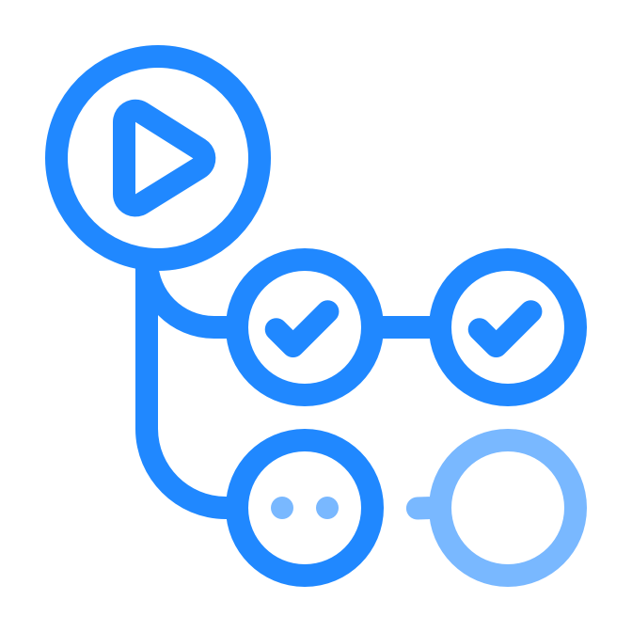
GitHub API
Follow best practices for integrators​
Adhere to rate limits​
Use pagination​
Use Octokit plugins
Understand GraphQL resource limitations and query costs​
Notes:
Regardless of whether you choose to use a GitHub App or GitHub actions, there are a few points that are important to state that you should always adhere to:
- Follow Best practices for integrators
- Adhere to rate limits
- Use pagination
- Use Octokit plugins
- Understand GraphQL resource limitations and query costs
********************
Note to presenter:
Pleae provide these links to the audience. Review the points unter these URLs and decide which points are most applicable to your group. For example, under best practices, it would be very important to highlight how to "Secure payloads delivered from GitHub" found in the documentation of best practices.
Best practices: https://docs.github.com/en/rest/guides/best-practices-for-integrators
Rate limits: https://docs.github.com/en/rest/guides/best-practices-for-integrators#dealing-with-rate-limits
Pagination: https://docs.github.com/en/rest/guides/traversing-with-pagination
Octokit plugins: https://github.com/octokit?q=plugin
Resource limitations: https://docs.github.com/en/graphql/overview/resource-limitations
********************

Slide 12
Questions

